Slide 1
LIBRARY MANAGEMENT SYSTEM
Group member
Ankit Karki
Kushal Sharma
Sanjog Paudel
Vishwa Bandhu Adhikari

Slide 2
Existing System
Manual system
Issuing and receiving of the book is also complex
Time manipulation

Slide 3


Slide 4
Need for a New System WHY???
To solve the real problems of library.
Time consuming
Searching challenging task
Maintenances problem
Security problem
To provide replacement for manual system.

Slide 5
Objectives
Integrity
Better error handling
Speed improvement
More Accuracy
Data inconsistency
System will handle the maintenance of data.

Slide 6
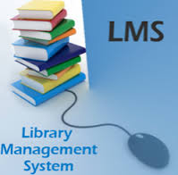

Slide 7
HOW????
System Analysis
Algorithm and flowchart
programming language.

Slide 8
Project Profile
Our aim
Students can easily take and issue books
Students delight by delivering on time and fast service
Maintain for generating various reports

Slide 9
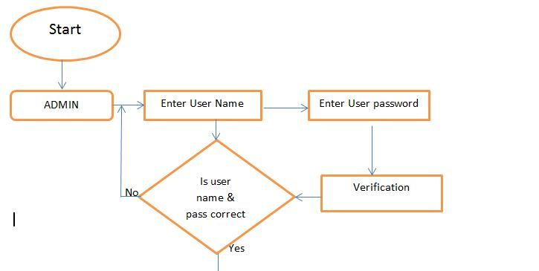
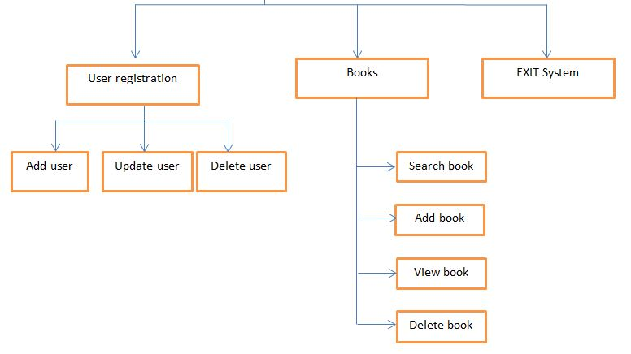
Flow chart

Slide 10
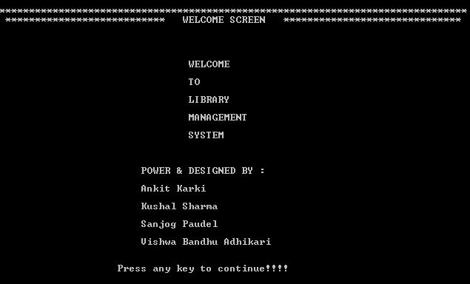
Welcome Screen

Slide 11
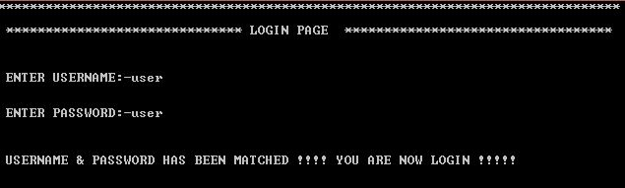
LOGIN PAGE

Slide 12
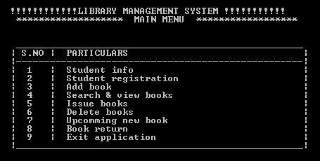
MAIN MENU

Slide 13
SOFTWARE NEEDED
C programming language.

Slide 14
ADVANTAGE OF THIS SYSTEM
Efficiency
Simplicity
Password Protected
Ease of use
Book wise search can be performed
Every thing will me handled by administrator(books, authors, existing member etc.).

Slide 15
LIMITATIONS
No GUI
No built-in collections library
No built-in support for networking, sound, graphics, etc.

Slide 16
Conclusion
It is easy to update information by using this technology.
Saves cost of handling(storing).
The way of storing and retrieving data becomes easier and faster.
Efficient recording.
Implementation of technology helps to compete with other similar organization.
OLD IS GOLD.

Slide 17


Slide 18
REFERENCE
Mimage.com
https://www.scribd.com/doc/127263774/Library-System-Flowchart
http://www.slideshare.net/smitpatel10192/library-management-system-presentation

Slide 19

ANY QUERIES????

Slide 20
Thank you.

